Slide 1

Intro to Tableau
Story-Telling Through Data Visualization
By: Alex Sorenson
Tableau Public Download
https://public.tableau.com/
Datasets
https://www.heyalexs.com/Data.zip

Slide 2


Slide 3


Slide 4
Smart Data Solution Center

Slide 5


Slide 6
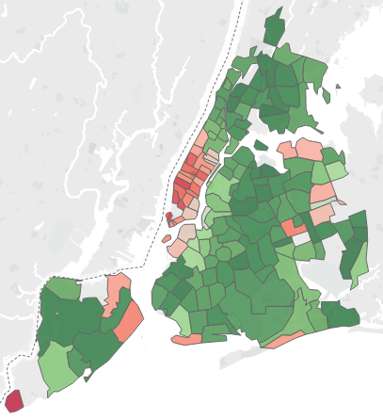
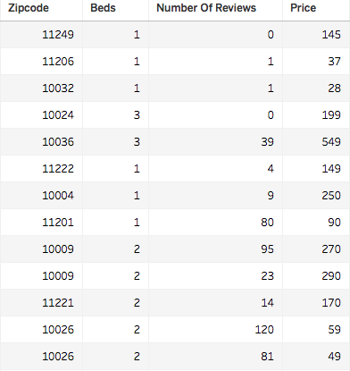

Slide 7
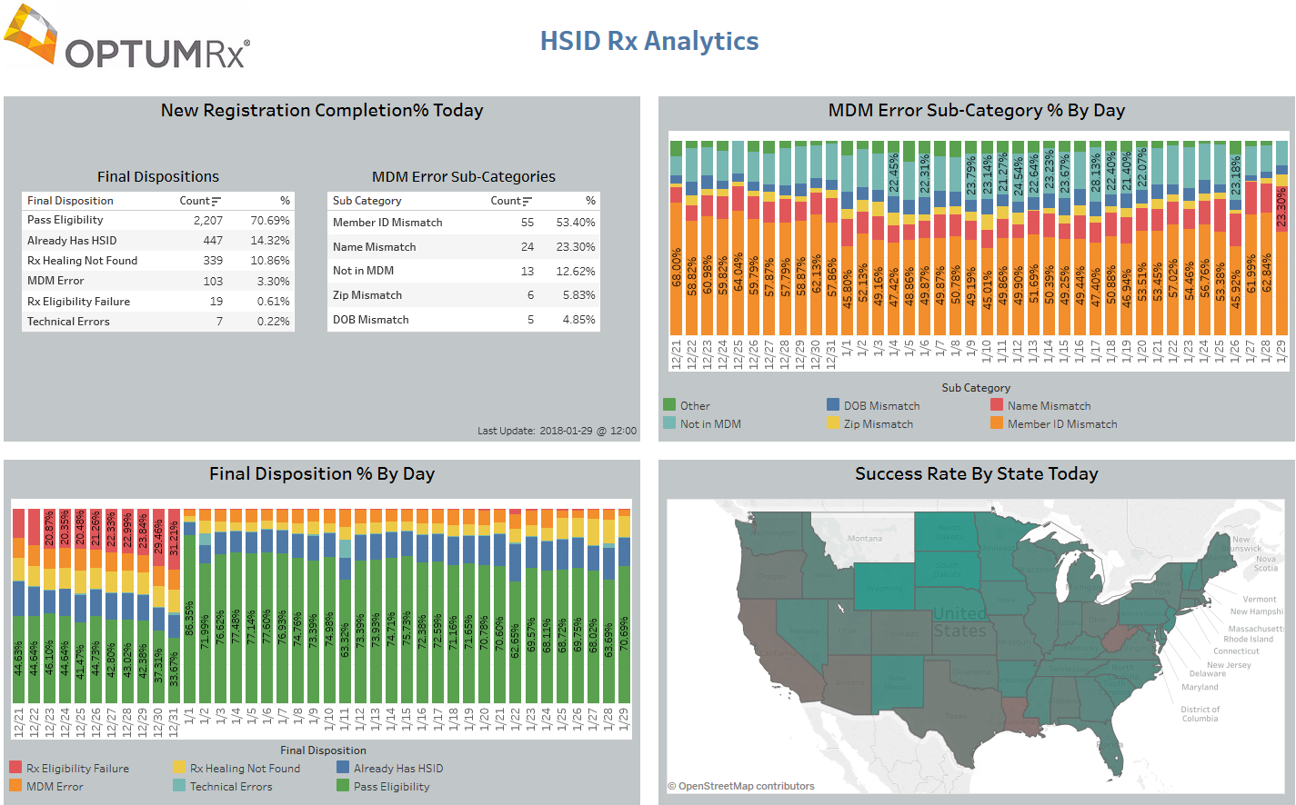
HSID Dashboard

Slide 8
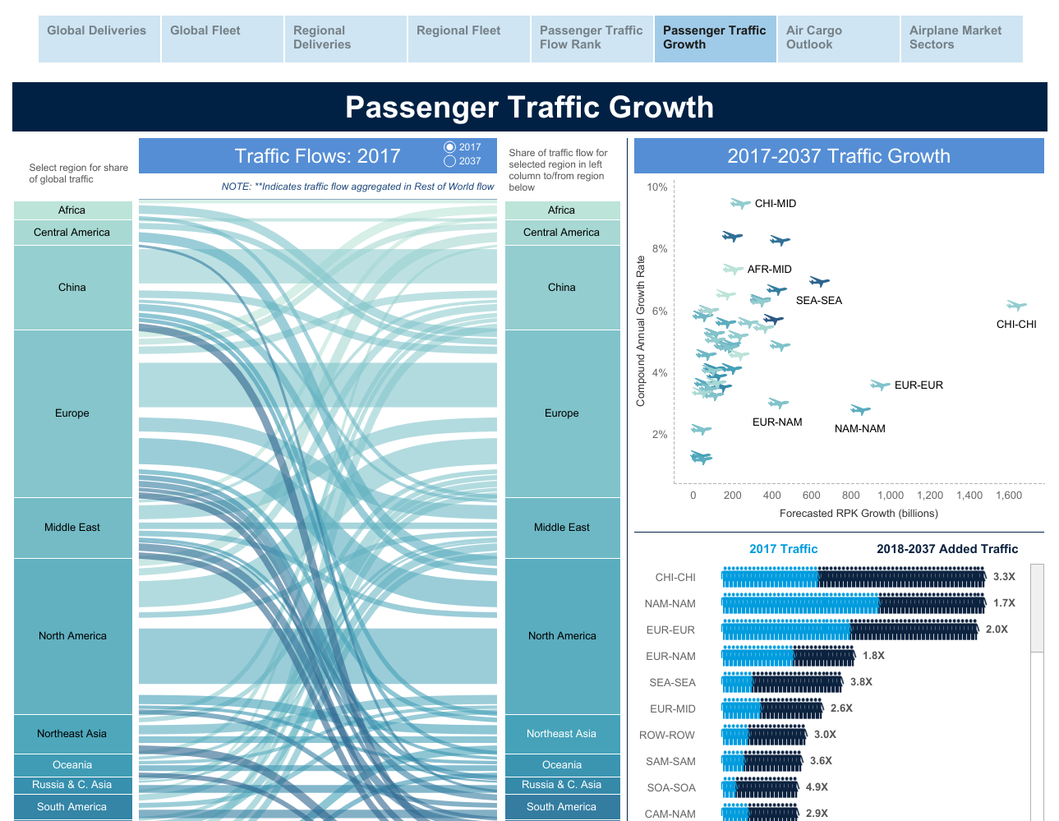

Slide 9
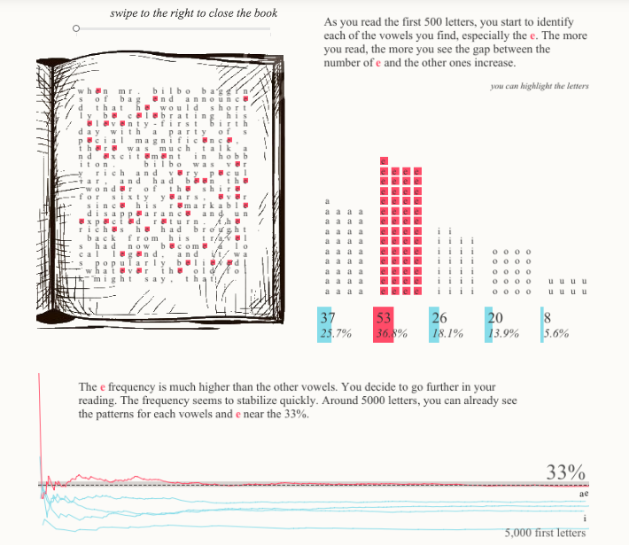

Slide 10
Tableau Public Download: https://public.tableau.com/
Datasets: https://www.heyalexs.com/Data.zip

